Slide 1
SREERAG K R

Slide 2
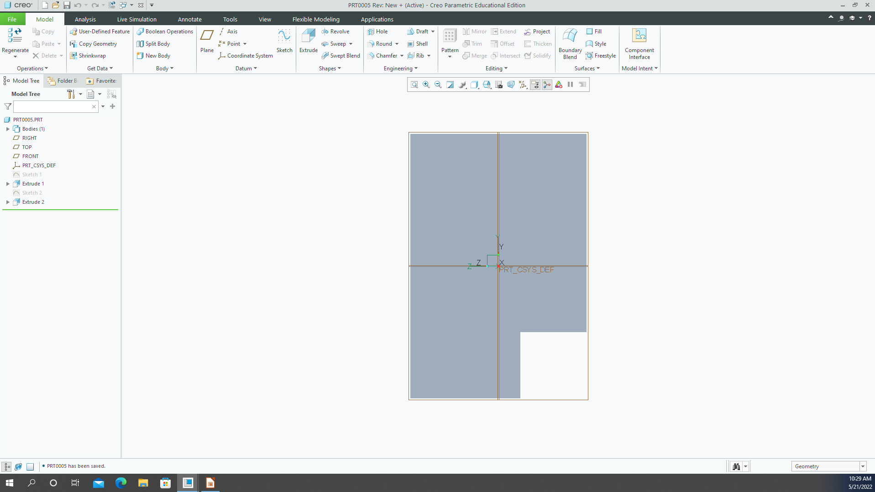
Figure 1

